Slide 1

MALIGNANT COMMENT CLASSIFIER
Presented by:
Asif ansar

Slide 2
Problem Statement
The expansion of social media enables users to express their opinions widely online.
This has resulted in the emergence of conflict and hate, making online environments inconvenient for users.
Online hate, described as abusive language, aggression, cyberbullying, hatefulness and many others has been identified as a major threat on online social media platforms.
Many celebrities and influencers are facing backlashes from people and have to come across hateful and offensive comments.
This can take a toll on anyone and affect them mentally leading to depression, mental illness, self-hatred and suicidal thoughts.
Our goal is to build a prototype of online hate and abuse comment classifier which can be used to classify hate and offensive comments so that it can be controlled and restricted from spreading hatred and cyberbullying.

Slide 3
Machine Learning
Machine Learning is a subfield of Artificial Intelligence (AI) that works with algorithms and technologies.​
Machine Learning (ML) is categorized into two groups:​
Supervised ML: In supervised ML, we are given a dataset and already know our output, having the idea of relationship between input and output data. Supervised machine learning problems are categorized into regression and classification problems.​
Unsupervised ML: In Unsupervised ML, there is no information or idea about output is known i.e there is no relationship between input and output data. We can derive structure by clustering the data based on the relationships among the variables in the data.​
In this project, we used supervised machine learning to predict the customer retention in Indian E-commerce using classification models.​

Slide 4
Exploratory Data Analysis
Data Visualization
Data Pre-Processing
Natural Language Processing
Lemmatization
Vectorization
Splitting the data into features and target
Building a model
Choosing the best model
Saving the model

Slide 5
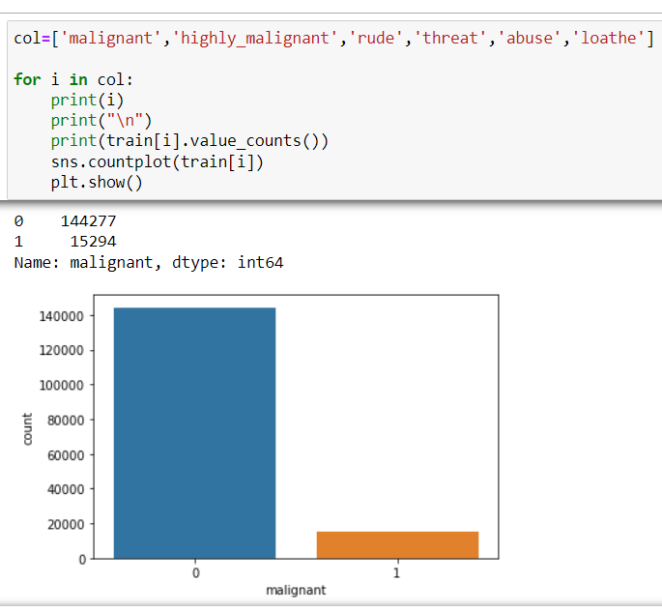
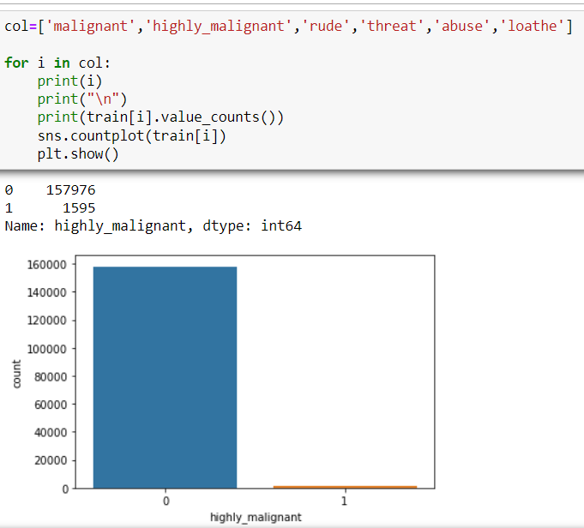
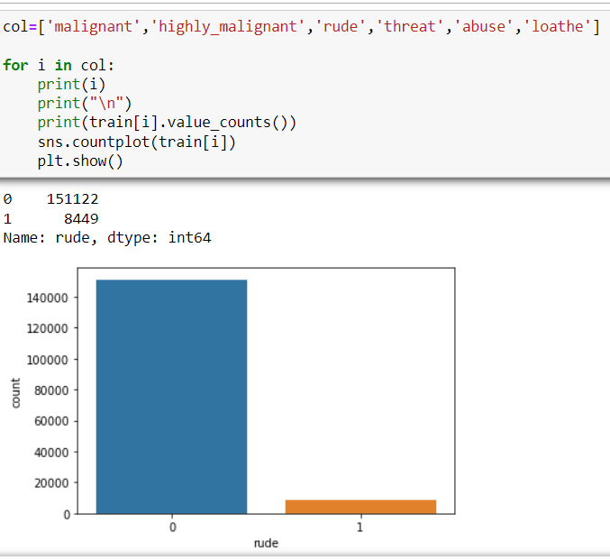
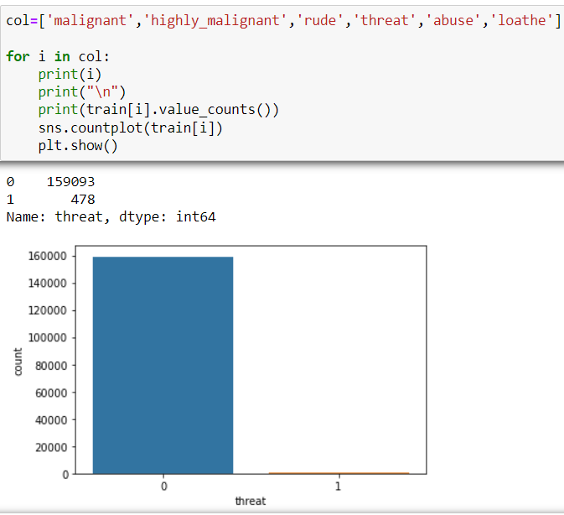
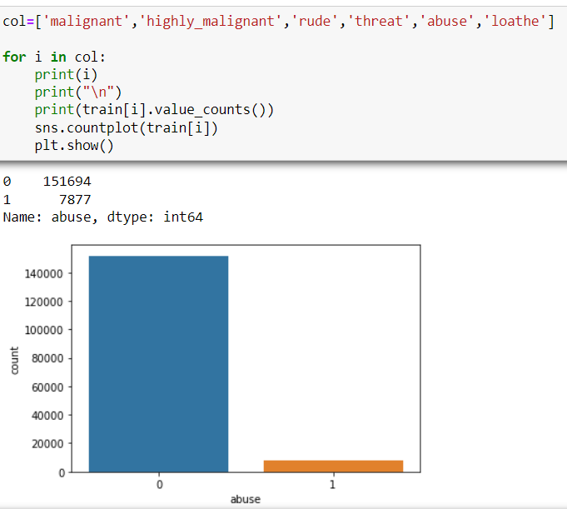

Visualizations
For the categorical data count plot is used to observe the relationship between input and target data.

Slide 6
Steps and Assumptions used
Finding if the null values are present. There are no null values present in this dataset.
Correlation: Finding the correlation between the target and input columns.
Describe of dataset: This gives the mean, standard deviation, maximum and minimum value.
Skewness: Skewness has been checked using normal distribution curve and been removed using power transform method.
Natural Language Processing: All the uppercase letters are converted into lower case, punctuations, web address and email, phone numbers are replaced.
Lemmatization is done.
Vectorization is done to convert the text into machine readable form.
Continued...

Slide 7
STEPS AND ASSUMPTIONS USED
tf-idf (term frequency-inverse document frequency) method is used to vectorize text.
The dataset has been divided into features and vectors.
Data scaling is done using standard scaler.
Building the model using classification technique and the best model is saved.

Slide 8
Model Dashboard
Classification models are used to predict the comment toxicity in this project.
Logistic Regression: It gives the relationship between the dependent and independent variables. It is used when the value of the target variable is categorical in nature.
Decision Tree Classifier: It is a tree-structured classifier, where internal nodes represent the features of a dataset, branches represent the decision rules and each leaf node represents the outcome.
KNNeighbors Classifier: In KNN, K is the number of nearest neighbors. The number of neighbors is the core deciding factor.
Random Forest Classifier: It consists of many decision trees. It uses bagging and feature randomness when building each individual tree and try to create an uncorrelated forest of trees whose prediction by committee is more accurate than that of any individual tree.
Continued......

Slide 9
Model Dashboard
Ada Boost Classifier: It is one of the ensemble boosting classifier that begins by fitting a classifier on the original dataset and then fits additional copies of the classifier on the same dataset.
Gradient Boosting Classifier: This classifiers combines many weak learning models together to create a strong predictive model.
XGBoost Classifier: It is an optimized Gradient Boosting technique.

Slide 10
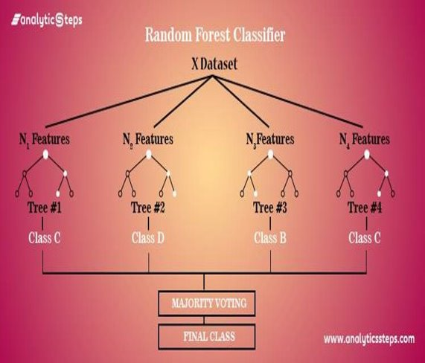
Finalised Model
Random Forest Classifier is chosen as a best model with 78% accuracy.

Slide 11
Conclusion
This research was conducted to predict the malignant comments from the given dataset.
Random Forest gave the best model with 78% prediction accuracy.

